Slide 1

Writing Tasks – week 12 – w.b. 15th June
Your writing for this week is going to be different each day. Each task is going to be themed around a different children’s film!

Slide 2
Day 1 – Charlie and the Chocolate Factory
Today we would like you to take your inspiration from Roald Dahl's famous tale, Charlie and the Chocolate Factory. Use the link to read through chapter 15 'The Chocolate Room'.
http://jssisdubai.com/DOCUMENT/UPLOADED/CHARLIEANDTHECHOCOLATEFACTORY.PDF

Slide 3
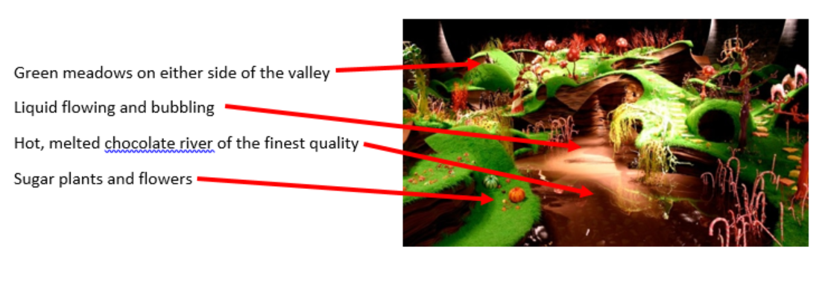
If you were to make a new room for the chocolate factory what would it be like?
Sketch, create and then annotate your ideas like the example below.

Slide 4

Day 2 – The Incredibles
Today you are going to be thinking about the film The Incredibles.
Watch the following link - https://www.youtube.com/watch?v=Htu-jKxJyEQ

Slide 5
If I were a superhero I would…
Today you need to produce a paragraph all about being a superhero. You need to think about:
- what special powers you would have and why?
- where in the world would you live and why?
- would you keep the fact you were a superhero secret? Why/why not?
- what would your outfit look like?
- would you use your powers for good or bad? Why?

Slide 6
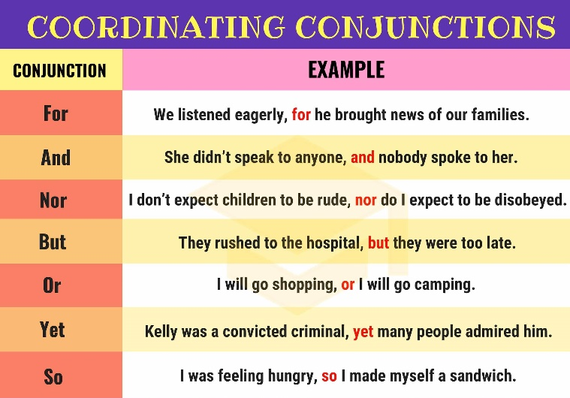
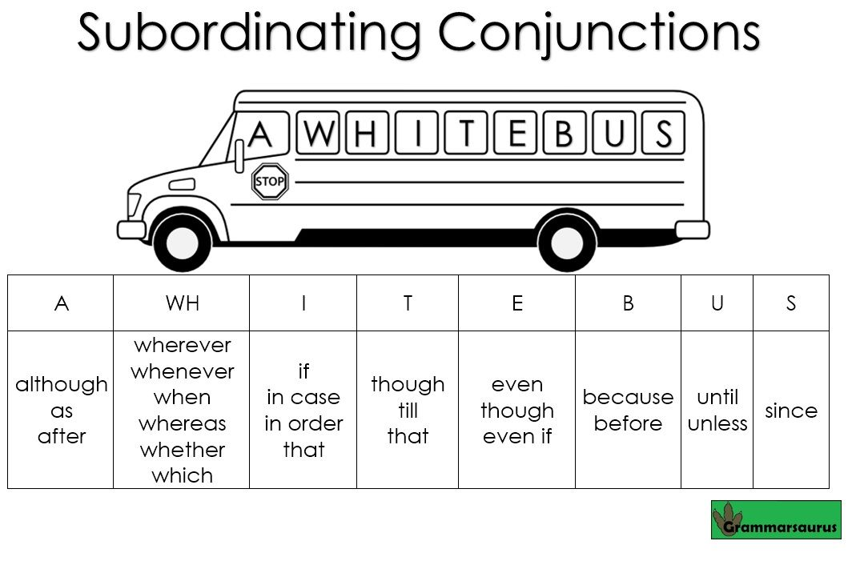
Please add anything else that you think would help to add to your thoughts about being a superhero. We are expecting a well-constructed paragraph to be produced and not just a list of answers to the questions. Think about using conjunctions, punctuation and parenthesis to help link your sentences together.

Slide 7
Day 3 – Toy story
For today’s writing you need to watch the following clip from Toy Story 3.
https://www.youtube.com/watch?v=Vwu385K3Oq0

Slide 8
Your task is to write a short, persuasive letter to Andy as a character from Toy Story explaining why he shouldn’t be giving you and your friends away. Remember, this needs to be convincing and written in the role of a specific character.
You could choose to write from the point of view of Woody, Buzz, Slinky, Mr Potato Head, Mrs Potato Head, Rex or Ham.

Slide 9
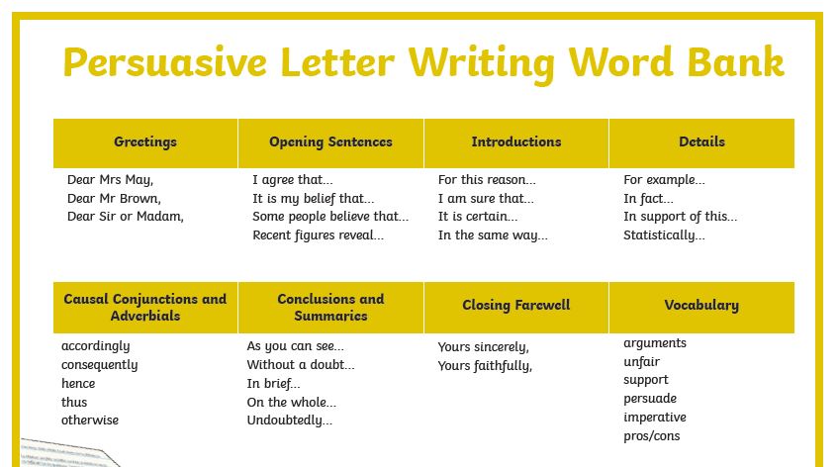

Slide 10


