Slide 1


Maths
Addition and Subtraction
Year One
Maths | Year 3 | Addition and Subtraction | Formal Written Methods | Lesson 4 of 8: My Hero!

Slide 2
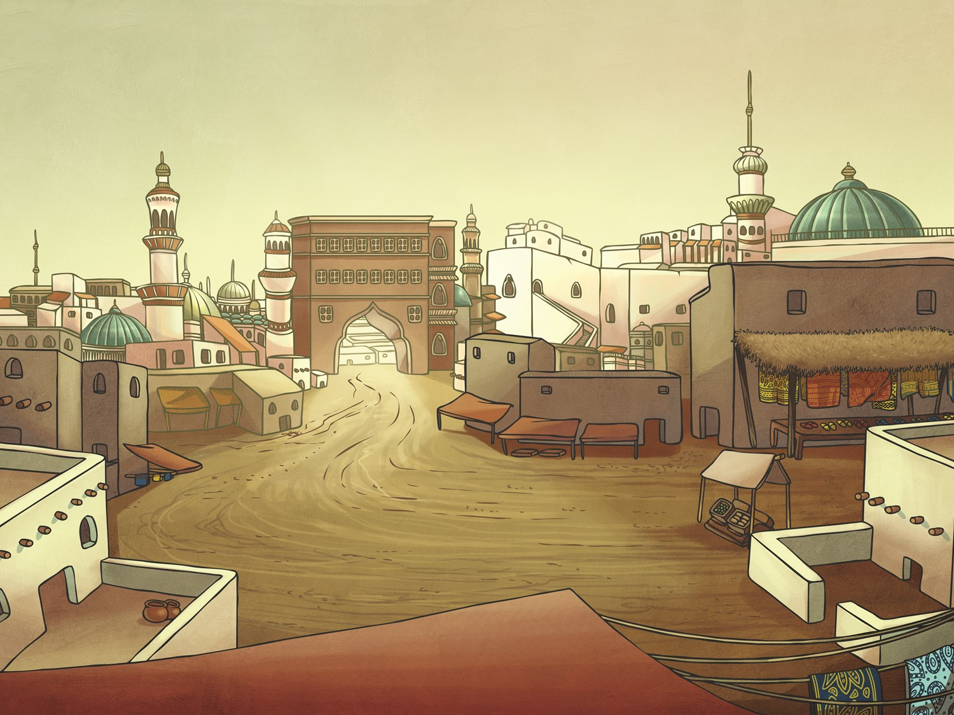
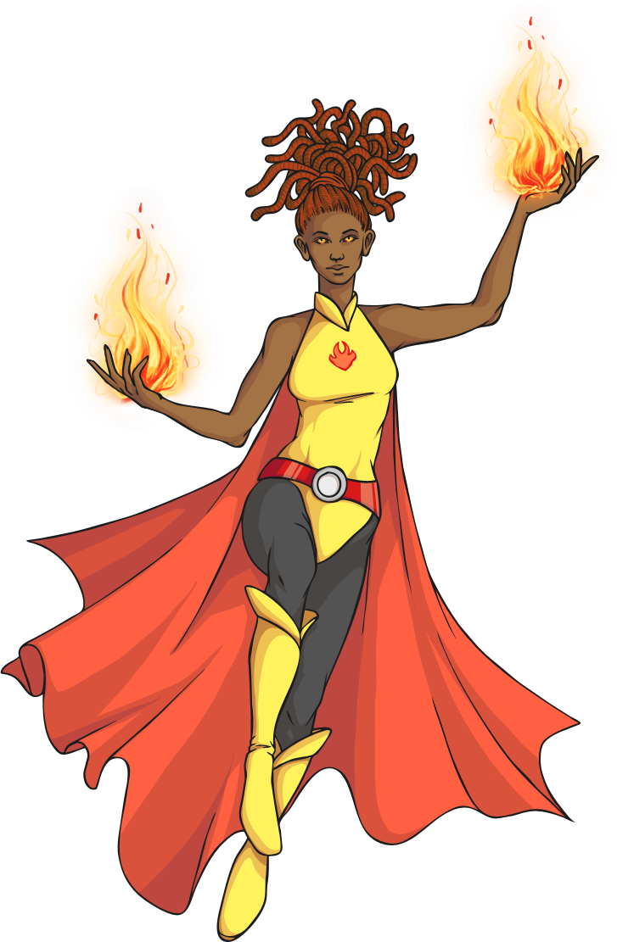
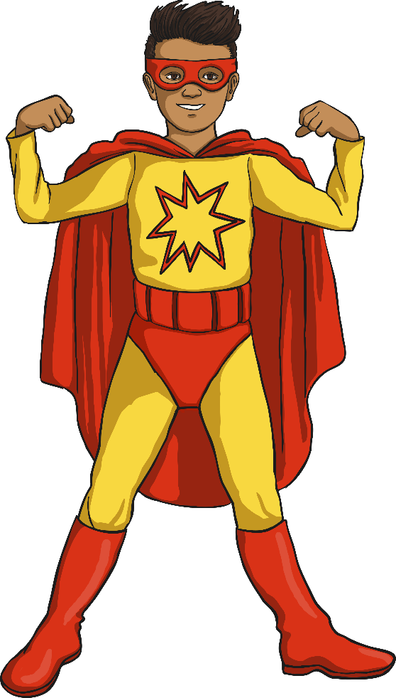

My Hero!

Slide 3
Aim
I can add numbers with up to three digits using a formal written method.
Success Criteria
I can add numbers using a formal method.
I can add numbers with up to three digits.
I can add numbers crossing the tens boundary.
I can add numbers crossing the hundreds boundary.

Slide 4
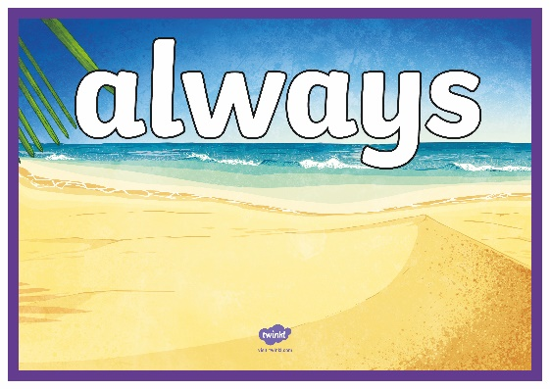
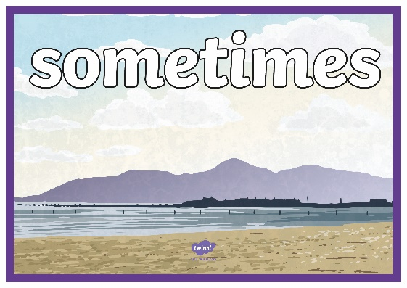
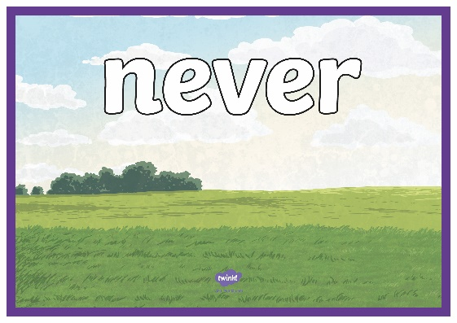
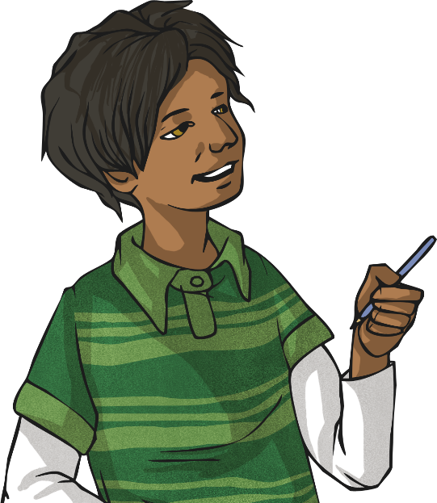

Always, Sometimes, Never
Listen to the statement.
Go to the most suitable sign.
Explain your choice.
If your choice was incorrect, you are out of the game.
The last player wins!

Slide 5
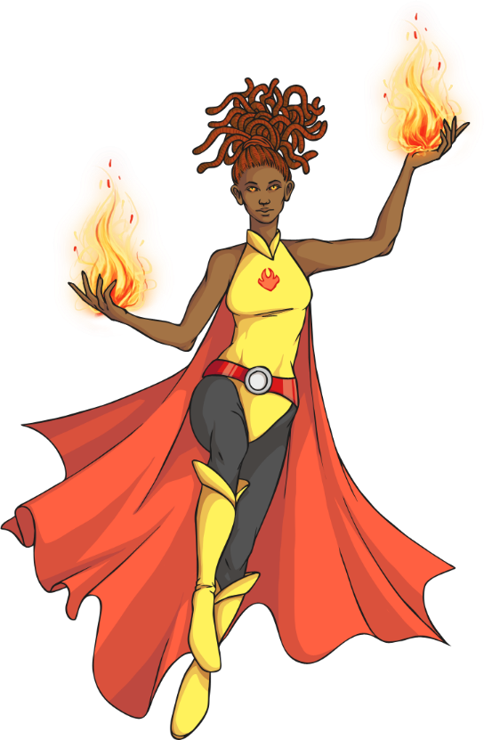


Defeating Villains
Oh no! The villains have been creating chaos in the city.
The only way to beat them is to solve mathematical
problems to disable their terrible contraptions. How can we add 2 three-digit numbers using a written method?
Add the ones together.
453
395
+
3 + 5 = 8 = 8 ones
8
Place 8 in the ones answer.

Slide 6

Defeating Villains
How can we add 2 three-digit numbers
using a written method?
Add the tens together.
453
395
Regroup the 14 tens into 1 hundred and 4 ten.
+
50 + 90 = 140 =
1 hundred + 4 tens
4
8
1
Place 4 in the tens answer and show the regrouped hundred by writing 1 under the hundreds column.

Slide 7
Defeating Villains
How can we add 2 three-digit numbers
using a written method?
Add the hundreds together.
453
395
400 + 300 + 100 = 800 =
8 hundreds
+
8
4
8
Place 8 in the hundreds answer.
1
The answer is 848.

Slide 8

Defeating Villains
Let’s see what the calculation looks like using base ten blocks.
Add the ones together.
453
395
3 + 5
+
+

Slide 9
Defeating Villains
Let’s see what the calculation looks like using base ten blocks.
453
395
3 + 5 = 8 = 8 ones
+
+
=

Slide 10
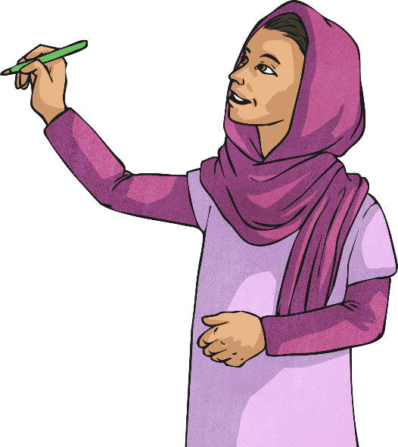
Defeating Villains
Let’s see what the calculation looks like using base ten blocks.
453
395
Place 8 in the ones answer.
+
8

Slide 11

Defeating Villains
Let’s see what the calculation looks like using base ten blocks.
453
395
Add the tens together.
50 + 90
+
+
8

Slide 12
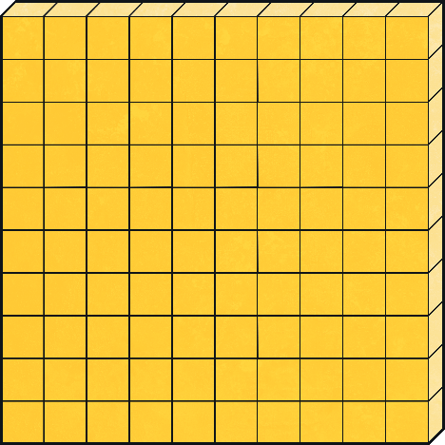

Defeating Villains
Let’s see what the calculation looks like using base ten blocks.
50 + 90 = 140 =
1 hundred + 4 tens
453
395
+
8

Slide 13
Defeating Villains
Let’s see what the calculation looks like using base ten blocks.
Place 4 in the tens answer and 1 under the hundreds column.
453
395
+
4
8
1

Slide 14
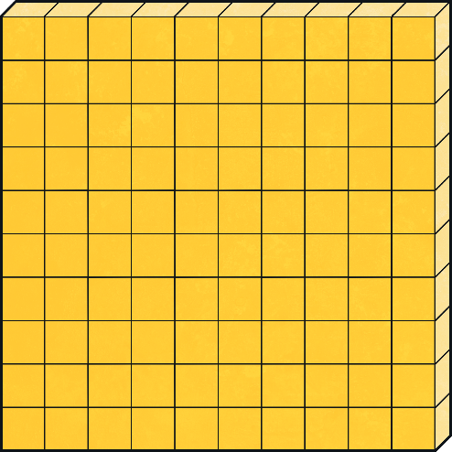
Defeating Villains
Let’s see what the calculation looks like using base ten blocks.
Add the hundreds together.
400 + 300 + 100 = 800
453
395
+
4
8
1

Slide 15
Defeating Villains
Let’s see what the calculation looks like using base ten blocks.
Place 8 in the hundreds answer.
453
395
+
8
4
8
1

Slide 16
Defeating Villains
Let’s see what the calculation looks like using base ten blocks.
The answer is 848.
453
395
+
8
4
8
1

Slide 17
Defeating Villains
How can we add 2 three-digit numbers using
a written method? Let’s try with a different number.
Add the ones together.
874
348
Regroup the 12 ones into
1 ten and 2 ones.
+
2
4 + 8 = 12 = 1 ten and 2 ones
1
Place 2 in the ones answer and show the regrouped ten by writing 1 under the tens column.

Slide 18
Defeating Villains
How can we add 2 three-digit numbers
using a written method?
Add the tens together.
874
348
Regroup the 12 tens into 1 hundred and 2 tens.
+
70 + 40 + 10 = 120 =
1 hundred + 2 tens
2
2
Place 2 in the tens answer and show the regrouped hundred by writing 1 under the hundreds column.
1
1

Slide 19
Defeating Villains
How can we add 2 three-digit numbers
using a written method?
Add the hundreds together.
874
348
Regroup the 12 hundreds into 1 thousand and 2 hundreds.
+
800 + 300 + 100 = 1200 =
1 thousand and 2 hundreds
2
2
2
1
1
Place 2 in the hundreds answer and show the regrouped thousand by writing 1 under the thousands column.

Slide 20
Defeating Villains
How can we add 2 three-digit numbers
using a written method?
Add the thousands together.
874
348
+
1000 + 0 = 1000
1
2
2
2
Place 1 in the thousands answer.
1
1
The answer is 1222

Slide 21
Defeating Villains
Let’s see what the calculation looks like using base ten blocks.
Add the ones together.
874
348
4 + 8
+
+

Slide 22

Defeating Villains
Let’s see what the calculation looks like using base ten blocks.
4 + 8 = 12 =
1 ten and 2 ones
874
348
+

Slide 23
Defeating Villains
Let’s see what the calculation looks like using base ten blocks.
Place 2 in the ones answer and 1 under the tens column.
874
348
+
2
1

Slide 24

Defeating Villains
Let’s see what the calculation looks like using base ten blocks.
Add the tens together.
874
348
+
+
2
1

Slide 25
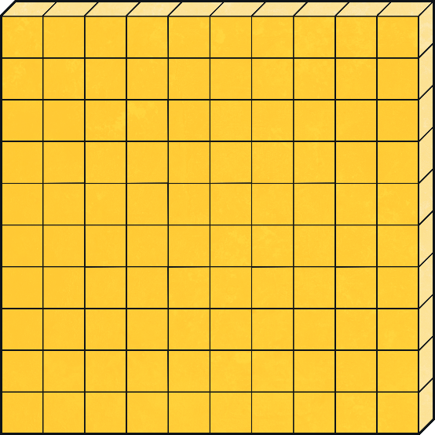

Defeating Villains
Let’s see what the calculation looks like using base ten blocks.
70 + 40 + 10 = 120 =
1 hundred + 2 tens
874
348
+
2
1

Slide 26
Defeating Villains
Let’s see what the calculation looks like using base ten blocks.
Place 2 in the tens answer and 1 under the hundreds column.
874
348
+
2
2
1
1

Slide 27
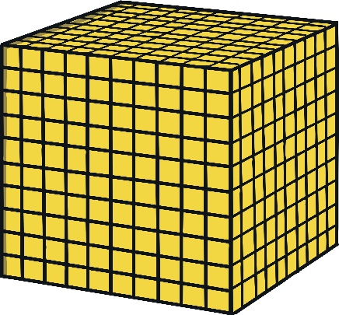
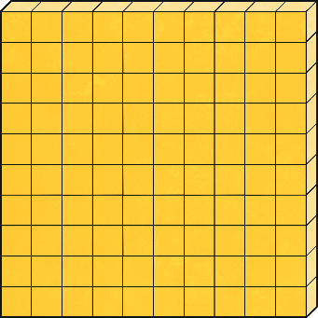
Defeating Villains
Let’s see what the calculation looks like using base ten blocks.
874
348
Add the hundreds together.
800 + 300 + 100 = 1200 =
1 thousand and 2 hundreds
+
2
2
1
1

Slide 28

Defeating Villains
Let’s see what the calculation looks like using base ten blocks.
Place 2 in the hundreds answer and 1 under the thousands column.
874
348
+
2
2
2
1
1
1

Slide 29
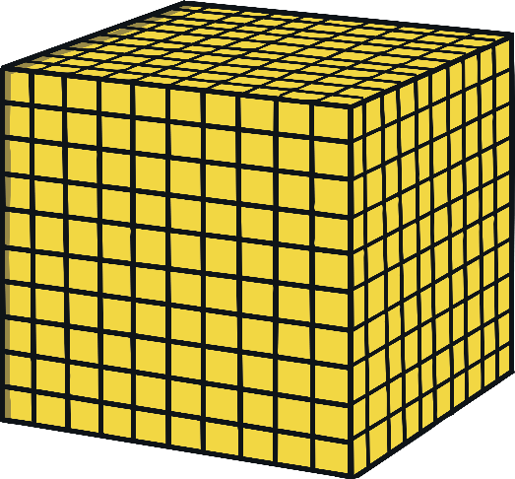
Defeating Villains
Let’s see what the calculation looks like using base ten blocks.
Add the thousands together.
874
348
1000 + 0 = 1000
+
2
2
2
1
1
1

Slide 30
Defeating Villains
Let’s see what the calculation looks like using base ten blocks.
Place 1 in the thousands answer.
874
348
+
1
2
2
2
1
1
1

Slide 31
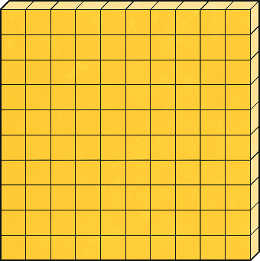


Defeating Villains
Let’s see what the calculation looks like using base ten blocks.
The answer is 1222.
874
348
+
1
2
2
2
1
1
1

Slide 32
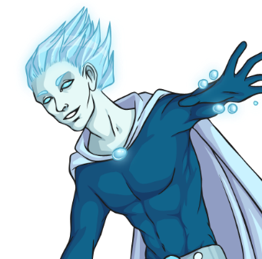
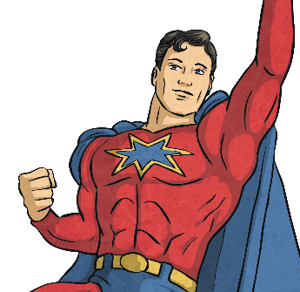

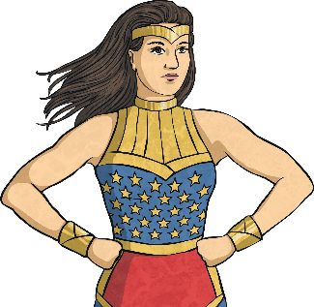
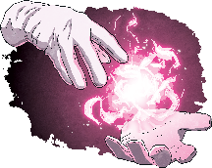




Super Powers
Match the power to the superhero. Click on the superhero to see the answer.
582 + 384
429 + 982
872 + 975
294 + 284
429 + 183
612
1847
966
1411
578

Slide 33
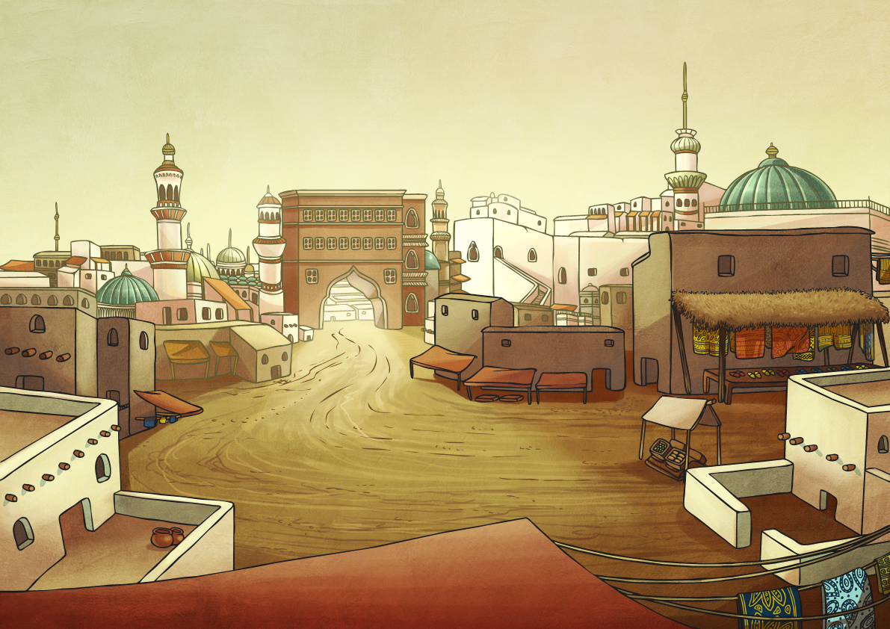

Superhero Saves the Day!
Help! Some people are trapped in a building.
Can you help save them or will you be
beaten by the nasty villain who has laid some traps?

Slide 34
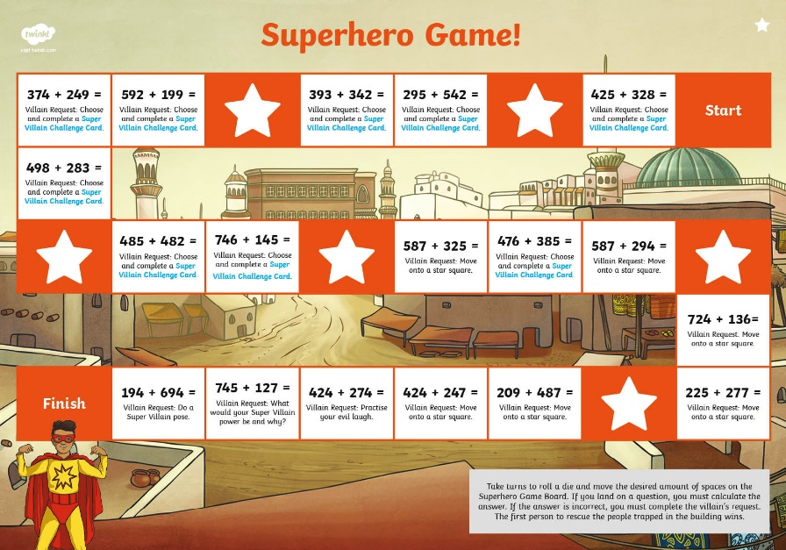


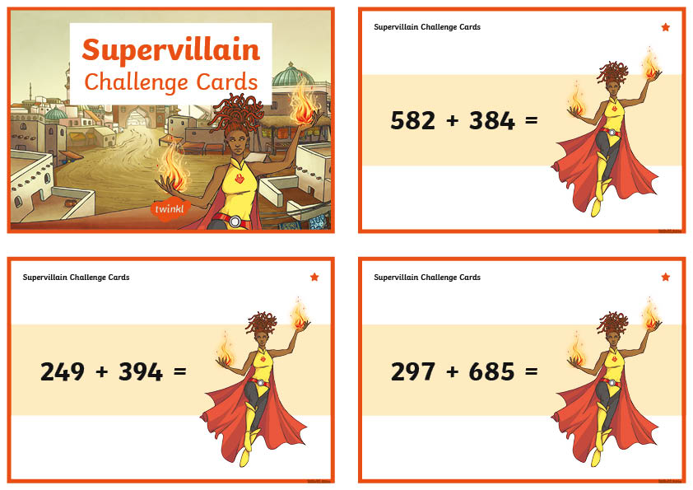
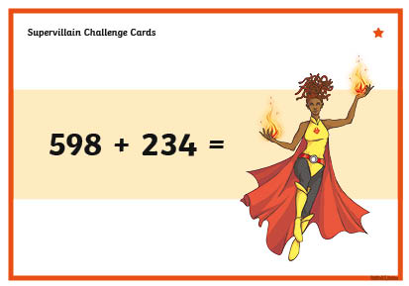
Superhero Saves the Day?
In pairs, you will be playing a game to defeat the evil villain and rescue the innocent people from the building.
Take turns to roll a die and move the desired amount of spaces on the Superhero Game Board.
If you land on a question, you must calculate the answer correctly. If you do not answer the question correctly, you will have to complete the Villain’s request.
Your answers could be checked using a calculator. The first to rescue the people trapped in the building wins.

Slide 35


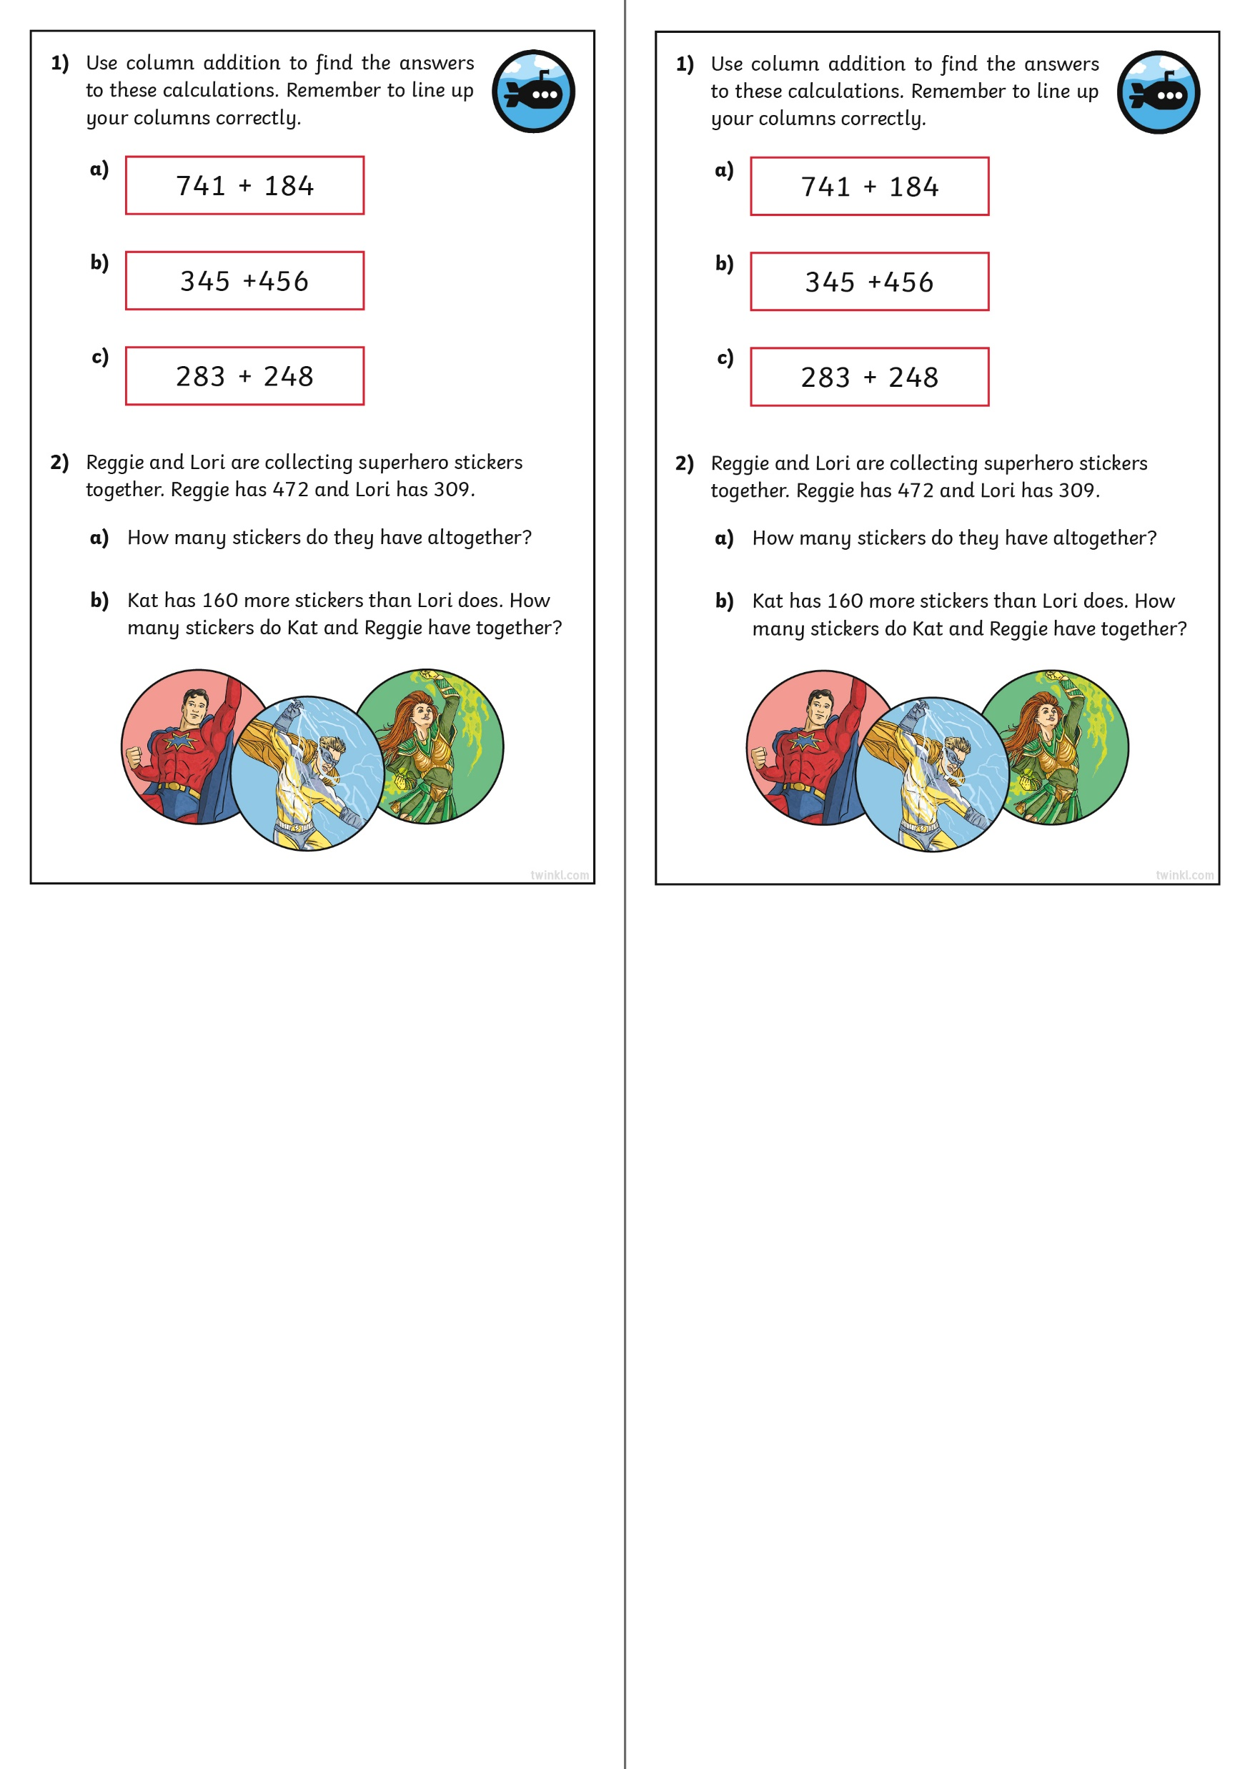
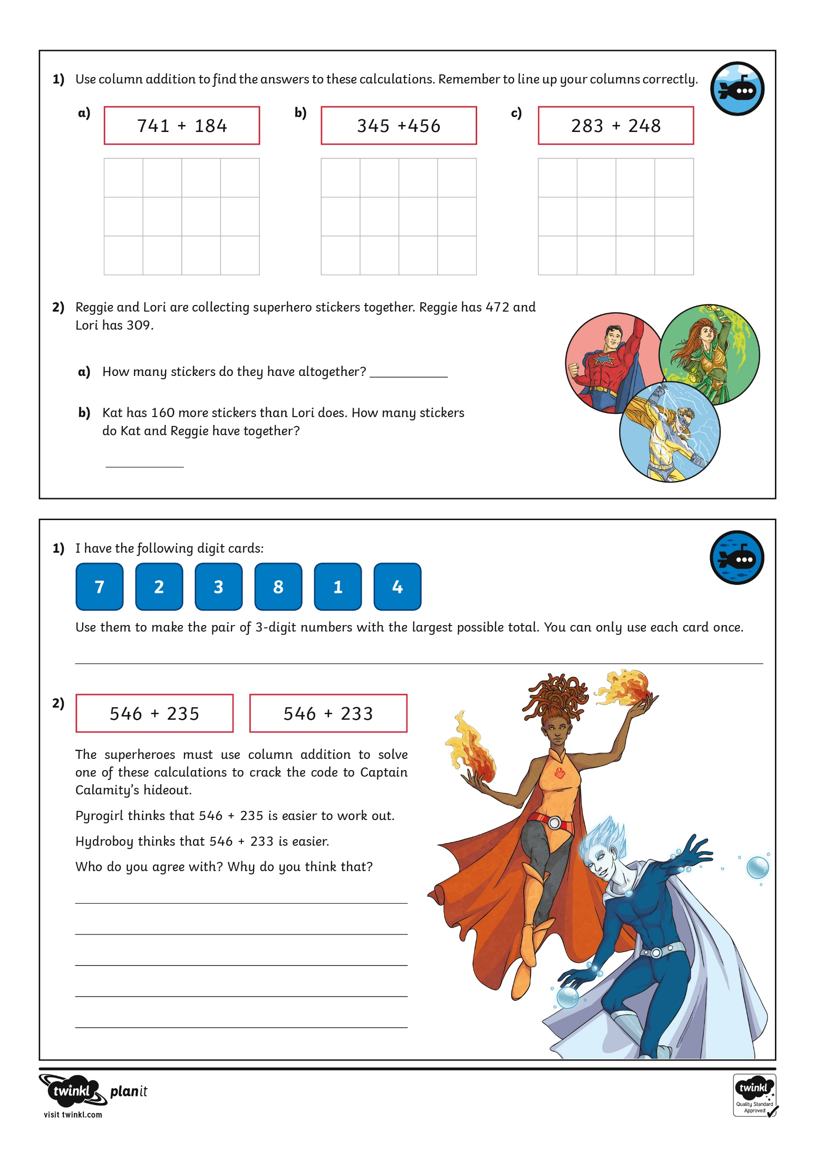

Diving into Mastery
Dive in by completing your own activity!

Slide 36
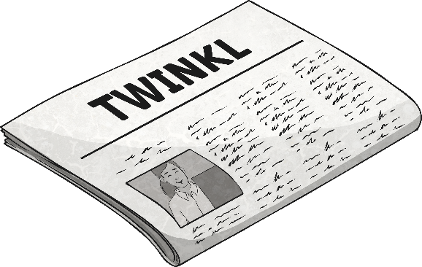
Answer
False Headlines
Is the headline true or false?
598 + 482 = 1080
True
False

Slide 37
Answer
False Headlines
Is the headline true or false?
589 + 292 = 781
True
False

Slide 38
Answer
False Headlines
Is the headline true or false?
592 + 844 = 1446
True
False

Slide 39
Answer
False Headlines
Is the headline true or false?
559 + 982 = 1541
True
False

Slide 40
Answer
False Headlines
Is the headline true or false?
582 + 790 = 1382
True
False

Slide 41
Aim
I can add numbers with up to three digits using a formal written method.
Success Criteria
I can add numbers using a formal method.
I can add numbers with up to three digits.
I can add numbers crossing the tens boundary.
I can add numbers crossing the hundreds boundary.

