Slide 1
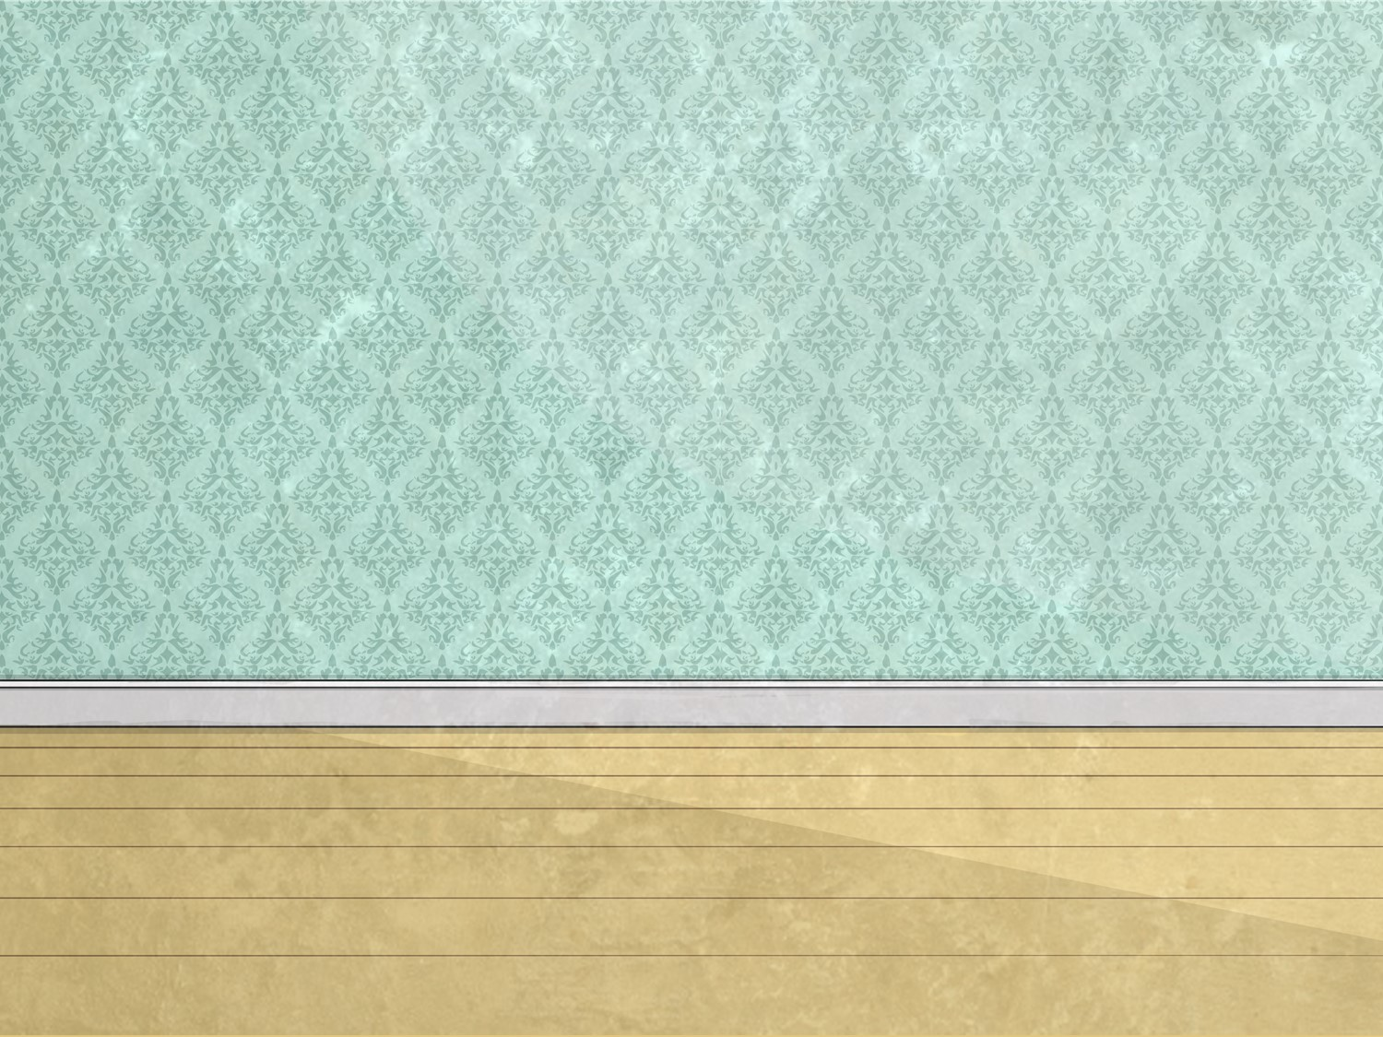
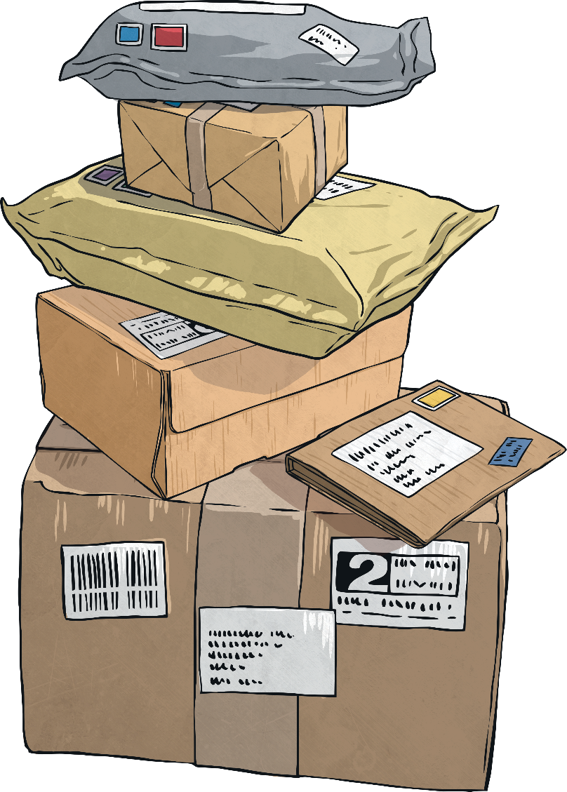

Sorting Office

Slide 2
Aim
I can subtract numbers up to three-digits using a formal written method.
Success Criteria
I can subtract numbers using a formal method.
I can subtract numbers up to three-digit numbers.
I can subtract numbers crossing the tens-boundary.

Slide 3

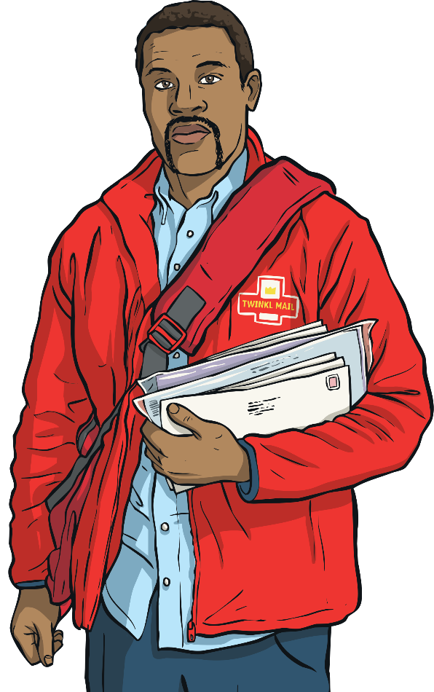

Finding the Mass
It has been chaos in the sorting office this morning!
Some of the parcels are too heavy so they have been made lighter.
Can you find the mass of each parcel now?

Slide 4
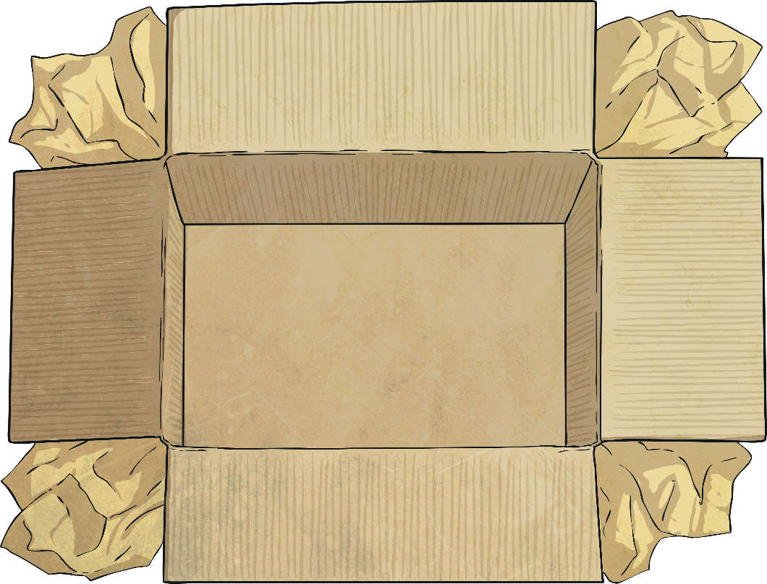
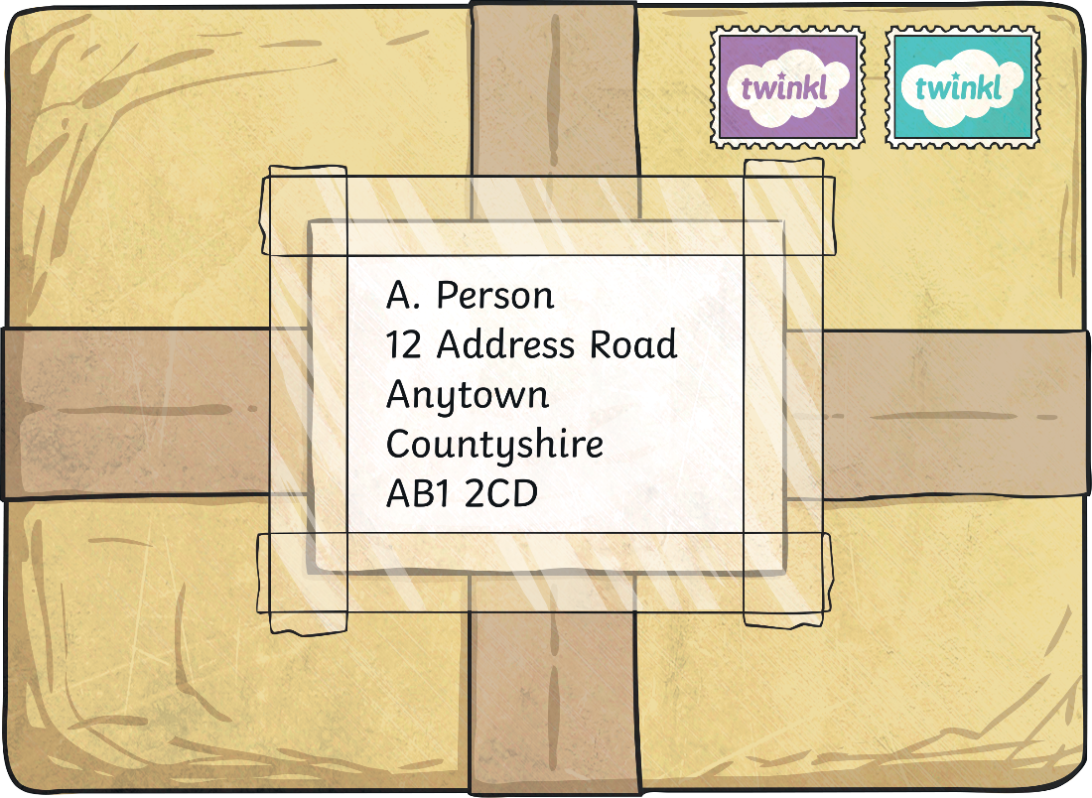
Finding the Mass
It has been chaos in the sorting office this morning!
Some of the parcels are too heavy so they have been made lighter.
Can you find the mass of each parcel now?
The parcel weighed 684 grams. 257 grams were removed. How much does the parcel weigh now?

Slide 5

Finding the Mass
The parcel has a mass of 684 grams. 257 grams were removed.
How much does the parcel weigh now?
Look at the ones column.
TO
Subtract the ones in the bottom column from the top column.
884
257
7
1
-
4 – 7 =
This cannot be done, so we need to ‘exchange’ a ten from the tens column.
7
14 – 7 = 7
Write 7 in the ones answer.

Slide 6
Finding the Mass
The parcel has a mass of 684 grams. 257 grams were removed.
How much does the parcel weigh now?
TO
Look at the tens column.
884
257
1
7
Subtract the tens in the bottom column from the top column.
-
7 tens - 5 tens = 2 tens.
7
2
Write 2 in the tens answer.

Slide 7
Finding the Mass
The parcel has a mass of 684 grams. 257 grams were removed.
How much does the parcel weigh now?
TO
Look at the hundreds column.
884
257
Subtract the hundreds in the bottom column from the top column.
1
7
-
8 hundreds - 2 hundreds = 6 hundreds.
7
2
6
Write 6 in the hundreds answer.
884 – 257 = 627

Slide 8


Finding the Mass
The parcel has a mass of 684 grams. 257 grams were removed.
How much does the parcel weigh now?
Look at the ones column.
TO
Subtract the ones in the bottom column from the top column.
884
257
1
7
4 – 7 =
This cannot be done, so we need to ‘exchange’ a ten from the tens column.
-
7
14 – 7 = 7
Write 7 in the ones answer.

Slide 9
Finding the Mass
The parcel has a mass of 684 grams. 257 grams were removed.
How much does the parcel weigh now?
TO
Look at the tens column.
884
257
1
7
Subtract the tens in the bottom column from the top column.
-
7 tens - 5 tens = 2 tens.
7
2
Write 2 in the tens answer.

Slide 10
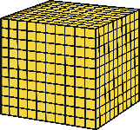
Finding the Mass
The parcel has a mass of 684 grams. 257 grams were removed.
How much does the parcel weigh now?
TO
Look at the hundreds column.
884
257
Subtract the hundreds in the bottom column from the top column.
1
7
-
8 hundreds - 2 hundreds = 6 hundreds.
7
2

Slide 11
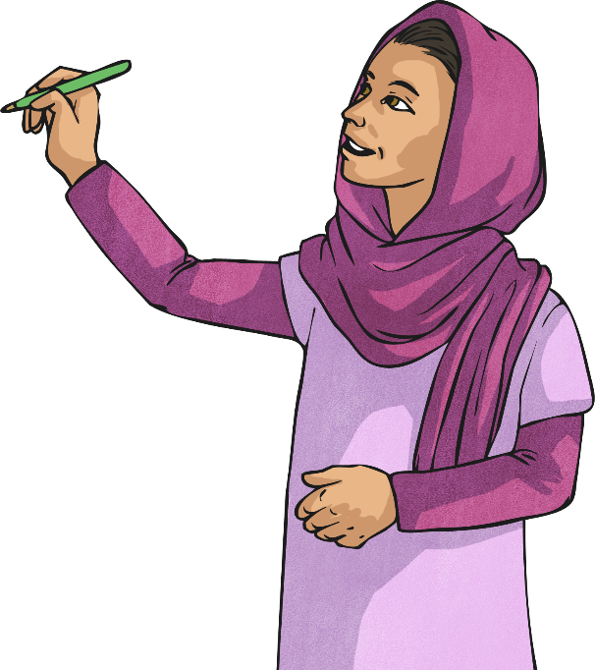
Finding the Mass
The parcel has a mass of 684 grams. 257 grams were removed.
How much does the parcel weigh now?
Write 6 in the hundreds answer.
TO
884
257
884 – 257 = 627
1
7
-
7
2
6

Slide 12
Finding the Mass
It has been chaos in the sorting office this morning.
Some of the parcels are too heavy so some of the weight has been taken out. Can you find the mass of each parcel now?
The parcel weighed 736 grams. 478 grams were removed. How much does the parcel weigh now?

Slide 13
Finding the Mass
The parcel has a mass of 736 grams. 478 grams were removed.
How much does the parcel weigh now?
Look at the ones column.
TO
Subtract the ones in the bottom column from the top column.
2
1
736
478
-
6 – 8 =
This cannot be done, so we need to ‘exchange’ a ten from the tens column.
8
16 – 8 = 8
Write 8 in the ones answer.

Slide 14
Finding the Mass
The parcel has a mass of 736 grams. 478 grams were removed.
How much does the parcel weigh now?
Look at the tens column.
TO
Subtract the tens in the bottom column from the top column.
6
1
2
1
736
478
20 – 70 =
This cannot be done so we need to ‘exchange’ one hundred (10 tens) from the hundreds column
-
5
8
12 tens – 7 tens = 5 tens
Write 5 in the tens answer.

Slide 15
Finding the Mass
The parcel has a mass of 736 grams. 478 grams were removed.
How much does the parcel weigh now?
Look at the hundreds column.
TO
Subtract the hundreds in the bottom column from the top column.
6
1
2
1
736
478
-
6 hundreds – 4 hundreds =
2 hundreds.
2
5
8
Write 2 in the hundreds answer.
736 – 478 = 258

Slide 16
Finding the Mass
The parcel has a mass of 736 grams. 478 grams were removed.
How much does the parcel weigh now?
Look at the ones column.
TO
Subtract the ones in the bottom column from the top column.
2
1
736
478
6 – 8 =
This cannot be done, so we need to ‘exchange’ a ten from the tens column.
-
8
16 – 8 = 8
Write 8 in the ones answer.

Slide 17

Finding the Mass
The parcel has a mass of 736 grams. 478 grams were removed.
How much does the parcel weigh now?
Look at the tens column.
TO
Subtract the tens in the bottom column from the top column.
6
1
2
1
736
478
20 – 70 =
This cannot be done so we need to ‘exchange’ one hundred (10 tens) from the hundreds column
-
5
12 tens – 7 tens = 5 tens
8
Write 5 in the tens answer.

Slide 18
Finding the Mass
The parcel has a mass of 736 grams. 478 grams were removed.
How much does the parcel weigh now?
Look at the hundreds column.
TO
Subtract the hundreds in the bottom column from the top column.
6
1
2
1
736
478
-
6 hundreds – 4 hundreds =
2 hundreds.
2
5
8
736 – 478 = 258
Write 2 in the hundreds answer.

Slide 19



Parcel Delivery
Using a formal written method, find the new mass of each parcel
and select which postage price to use.
Less than 200 grams £1.46
573
285
201 grams to 500 grams £2.24
-
288
501 + grams £5.00

Slide 20
Parcel Delivery
Using a formal written method, find the new mass of each parcel
and select which postage price to use.
Less than 200 grams £1.46
746
247
201 grams to 500 grams £2.24
-
499
501 + grams £5.00

Slide 21
Parcel Delivery
Using a formal written method, find the new mass of each parcel
and select which postage price to use.
Less than 200 grams £1.46
673
335
201 grams to 500 grams £2.24
-
338
501 + grams £5.00

Slide 22
Parcel Delivery
Using a formal written method, find the new mass of each parcel
and select which postage price to use.
Less than 200 grams £1.46
868
749
201 grams to 500 grams £2.24
-
119
501 + grams £5.00

Slide 23

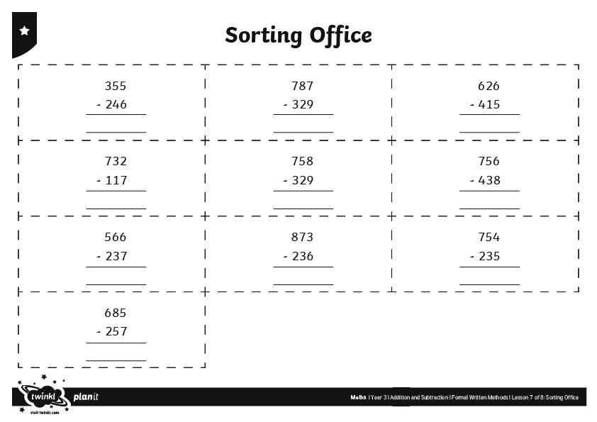
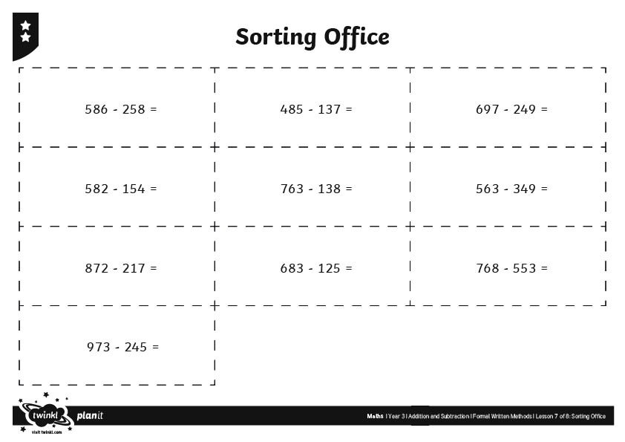
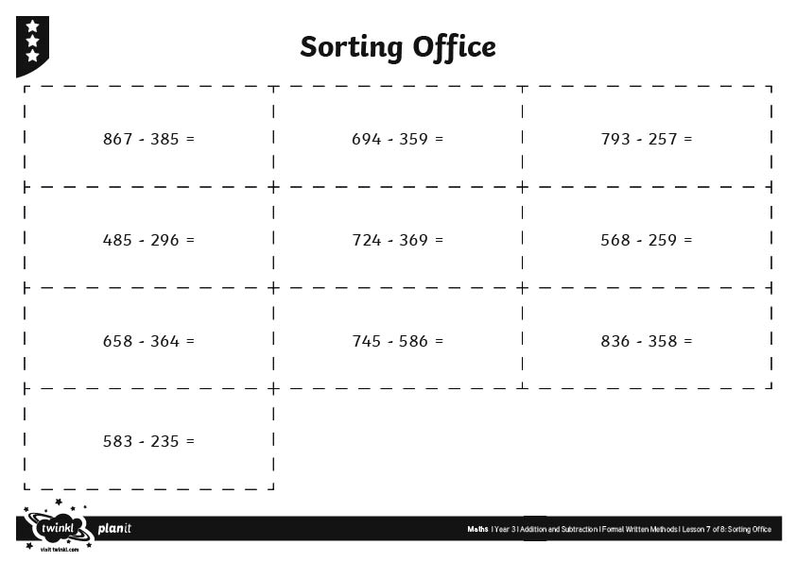
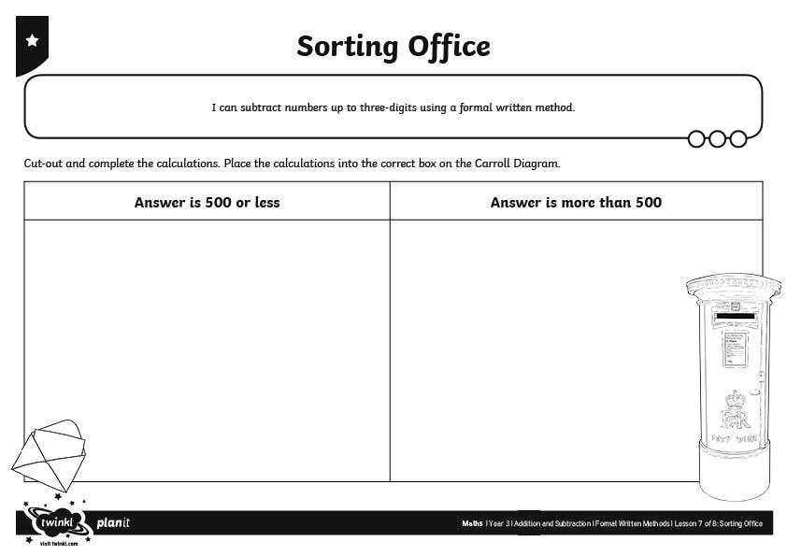
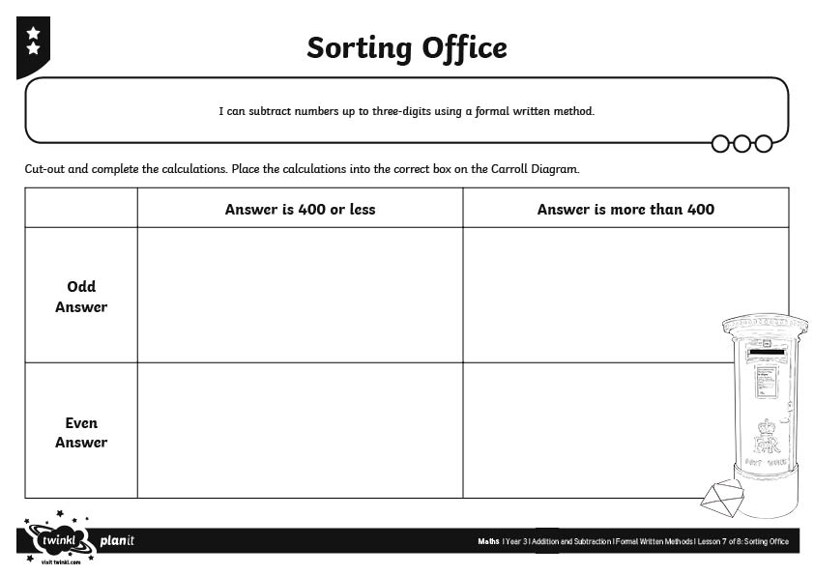
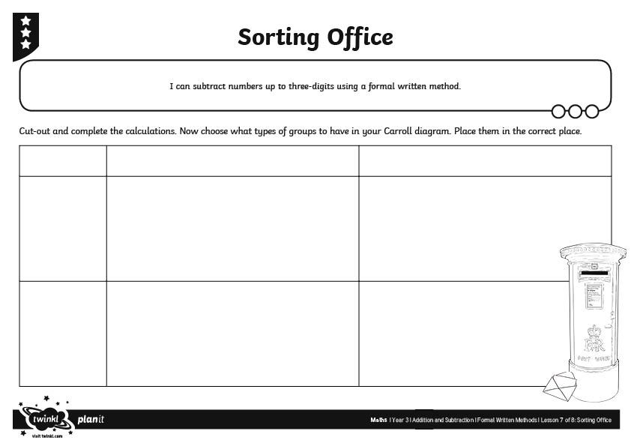
Sorting Office
You will be given a range of calculations to complete. Once completed, stick the calculation in the correct box on the Carroll Diagram.
Happy Sorting!

